Slide 1
Contract Monthly Claim System (CMCS)
Streamlining Lecturer Claim Submissions and Approvals
By Tahir Naranjee

Slide 2
Overview of the CMCS
The Contract Monthly Claim System (CMCS) is a .NET-based application that simplifies claim submission and approval processes for independent contractor lecturers.
Features include automated calculations, claim tracking, document uploads, and streamlined approvals.
Built using ASP.NET Core MVC, Entity Framework, and modern UI/UX principles.

Slide 3
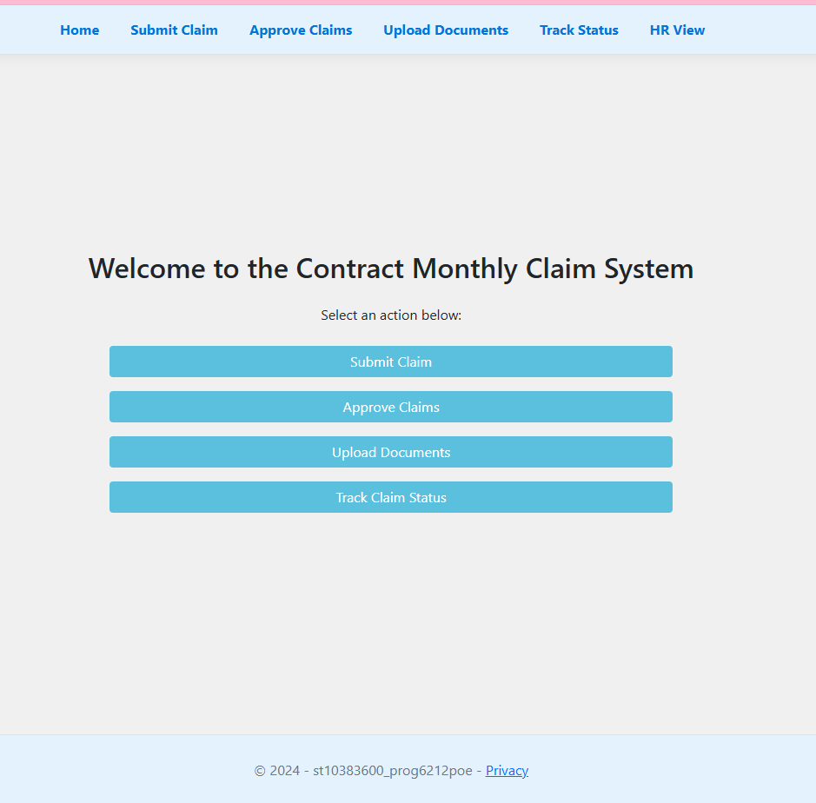
Home Page
Provides an intuitive entry point to all system functionalities: -
  Submit Claim
  Approve Claims
  Upload Documents
  Track Claim Status
  HR View
Provides user-friendly buttons for clear navigation.

Slide 4
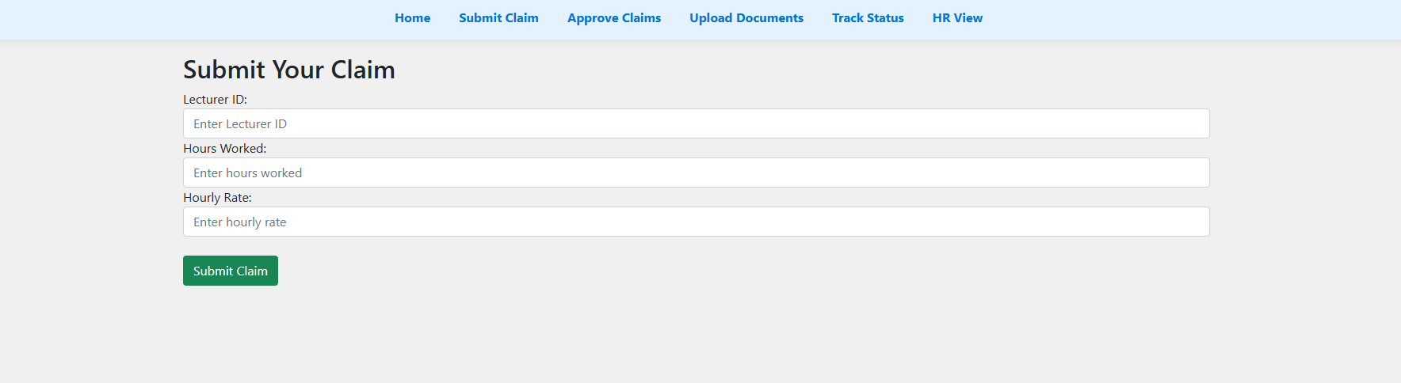
Submit Claims Page
Allows lecturers to submit claims with details:
  Hours Worked
  Hourly Rate
  Lecturer ID
  Auto-calculates the total claim amount.
  Includes validation checks to ensure accurate input.
Key Value: Reduces errors and simplifies claim submissions for lecturers.

Slide 5
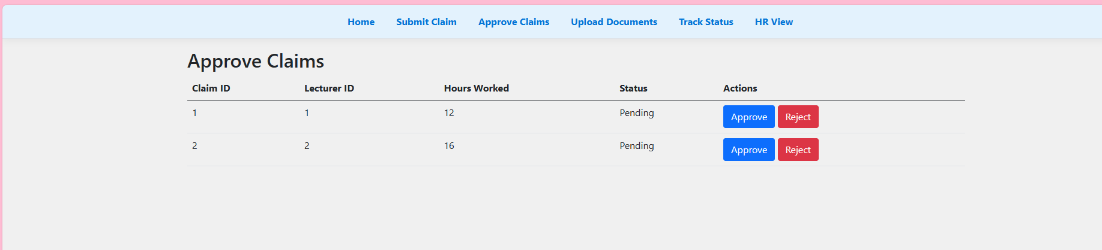
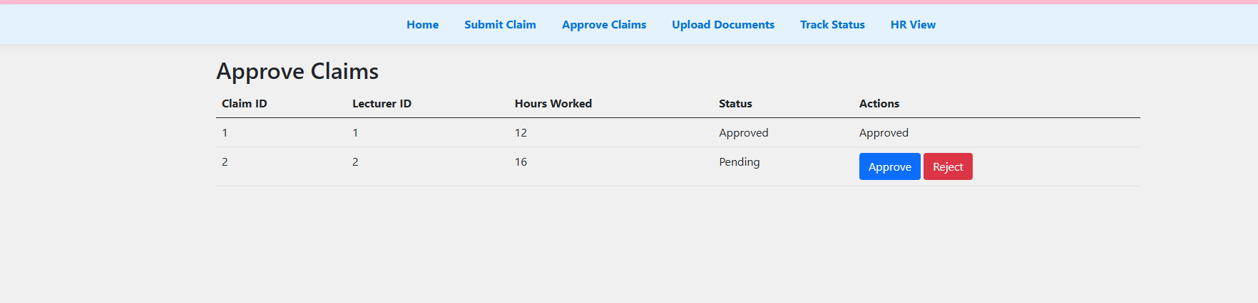
Approve Claims Page
Designed for program coordinators and academic managers:
  View all pending claims.
  Approve or reject claims with a single click.
  Update claim statuses in real-time.
  Provides an organised table with claim details.
Key Value: Enhances the approval process and ensures transparency.

Slide 6
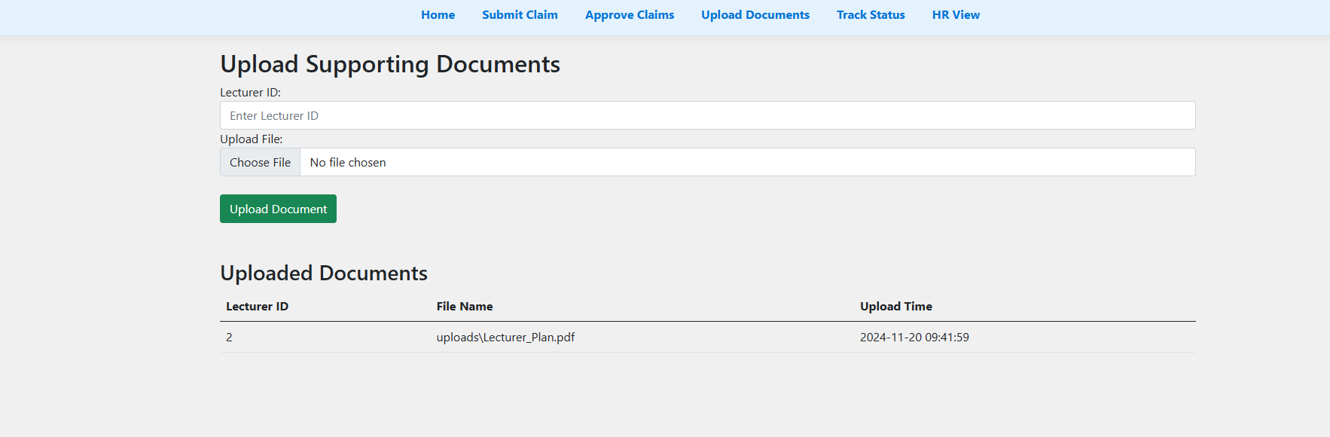
Upload Page
Lecturers can upload supporting documents (e.g., PDFs, DOCX, XLSX).
Includes security features like file type and size validation.
Displays uploaded documents in a table format for reference.
Key Value: Centralises document management and reduces paperwork.

Slide 7
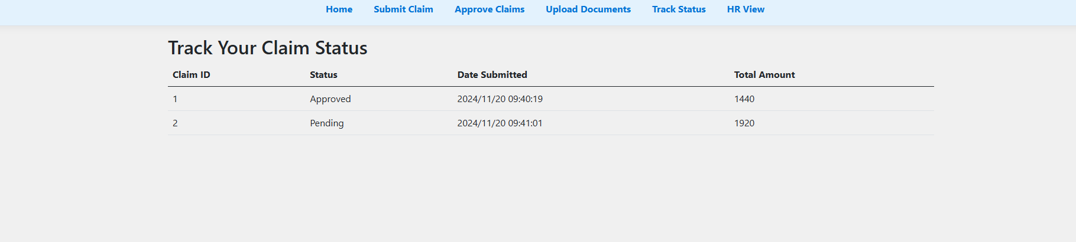
Track Claims Page
Lecturers can track the status of their claims (Pending, Approved, Rejected).
Displays submission dates and calculated total amounts.
Updates in real-time as claims are processed.
Key Value: Increases transparency and lecturer satisfaction.

Slide 8
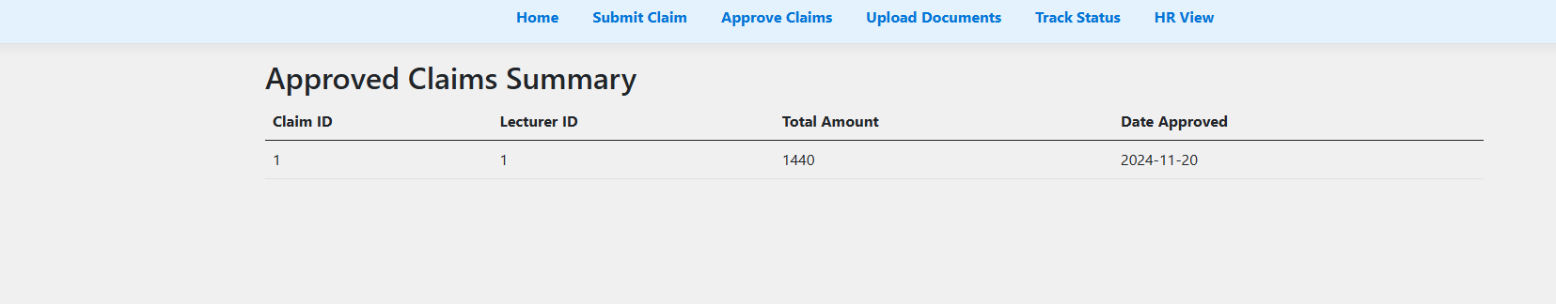
HR View Page
Provides HR personnel with:
  Summaries of approved claims.
  Automatic invoice/report generation (approved claims only).
  Access to detailed claim data.
  Simplifies payroll and administrative tasks.
Key Value: Saves time and reduces administrative burden.

Slide 9
Key Technologies and Features
Technologies Used:
ASP.NET Core MVC for backend logic.
Entity Framework for database operations.
jQuery for frontend validations.
Bootstrap for responsive design.
Automation Highlights:
Auto-calculation of claim amounts.
Validation of inputs and file uploads.
Real-time updates and approval workflows.

Slide 10
Why CMCS?
For Lecturers:
For Administrators:
For HR:
Simplified and transparent claim submissions.
Real-time tracking of claim status.
Efficient claim verification and approval.
Centralised document management.
Streamlined payroll processing with automated reporting.

Slide 11
Final Thoughts
The CMCS is a robust solution designed to modernise claim management.
By automating repetitive tasks, it saves time, reduces errors, and enhances transparency for all stakeholders.
Ready to be deployed and scaled for broader organisational needs.

Slide 12
Questions and Feedback
Feel free to ask questions about the system's design, features, and implementation.
Feel free to suggest implementations for further improvement.

